Slide 1
Data File Handling

Slide 2
Files
A file is a collection of related data stored in a particular area on the disk.
Programs can be designed to perform the read and write operations on these files
A program involves either or both of following kinds of data communication:
  Data transfer between the console unit and the program
  Data transfer between the program and a disk file

Slide 3
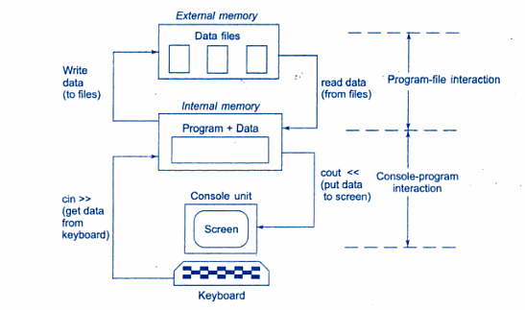
Console-program-file interaction

Slide 4
Introduction
Computer programs are associated to work with files as it helps in storing data & information permanently.
File - itself a bunch of bytes stored on some storage devices.
In C++ this is achieved through a component header file called fstream.h
The I/O library manages two aspects- as interface and for transfer of data.
The library predefine a set of operations for all file related handling through certain classes.

Slide 5
C++ provides a new technique for handling I/O operations through mechanism known as streams.
A stream refers to a flow of data.
Classified in 2 categories:
Output stream
Input stream
In output stream flow of data is from program to the output device.
In input stream the flow of data is from input device to a program in main memory.

Slide 6
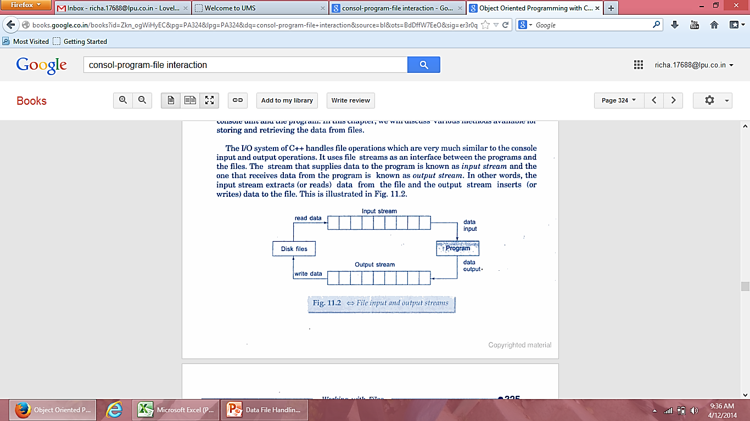
File Input and output streams

Slide 7
Classes for file stream operations
The I/O system of C++ contains a set of classes that define the file handling methods.
These include:
  ifstream
  ofstream
  fstream
  These classes are derived from fstreambase and from corresponding iostream class

Slide 8
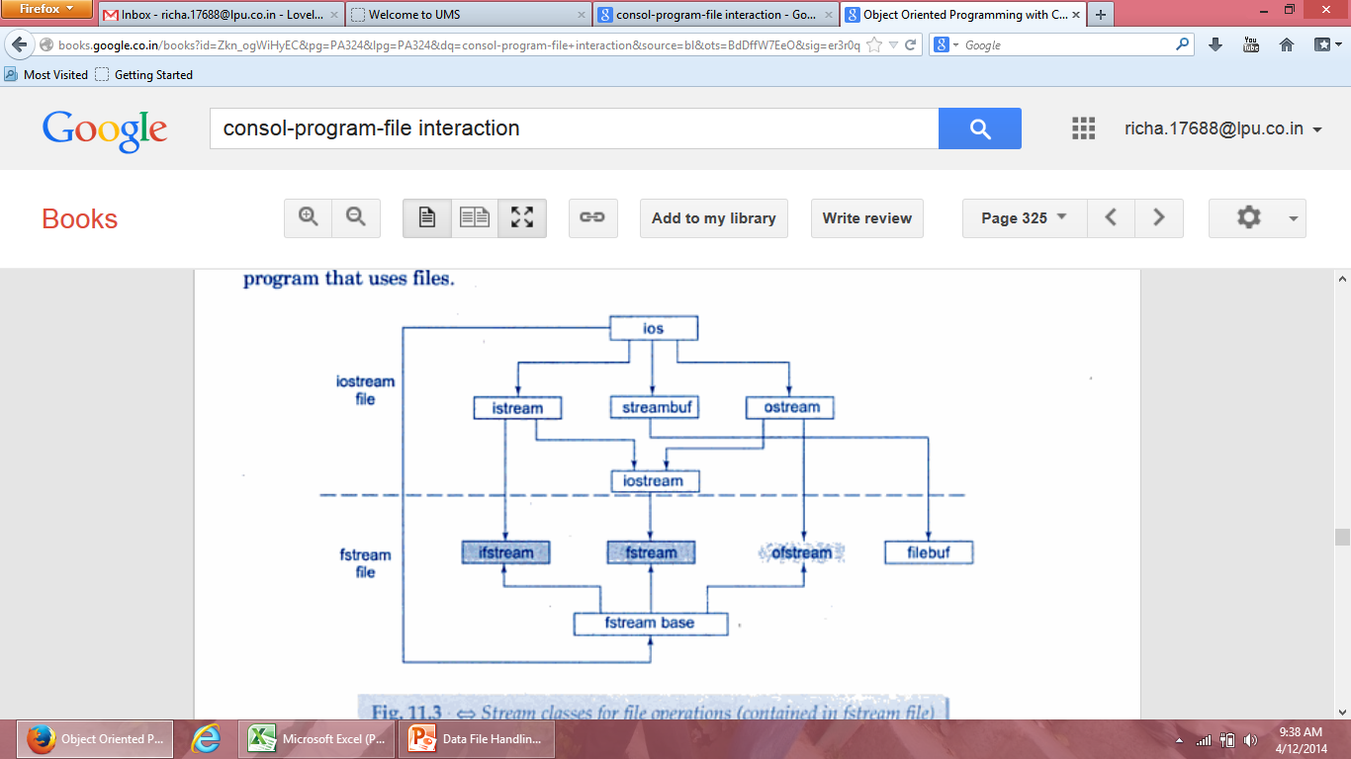
System defined streams
User defined streams
Stream classes for file operations

Slide 9
Why to use Files:
Convenient way to deal large quantities of data.
Store data permanently (until file is deleted).
Avoid typing data into program multiple times.
Share data between programs.
We need to know:
how to "connect" file to program
how to tell the program to read data
how to tell the program to write data
error checking and handling EOF

Slide 10
Opening and closing a file
If we want to use a disk file, we need to decide the following things:
  Suitable name for the file
  Data type and structure
  Purpose
  Opening Method

Slide 11
Filename
The file name is a string of characters that make up a valid filename for the operating system.
It has two parts, a primary name and an optional period with extension
Example:
  Input.dat
  Test.doc

Slide 12
Opening a file
For opening a file, we must first create a file stream and then link it to the filename.
A file stream can be defined using the classes ifstream, ofstream and fstream that are contained in the header file fstream
A file can be opened in two ways:
  Using a constructor function of the class
  Using the member function open() of the class

Slide 13
Opening files using constructor
Constructor is used to initialize an object while it is being created. Here, a filename is used to initialize the file stream object.
This involves following steps:
  Create a file stream object to manage the stream using appropriate class
  Initialize the file object with the desired filename.

Slide 14
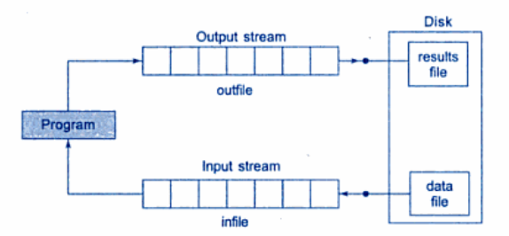
For example:
  ofstream outfile(“results”); // output only
This creates outfile as an ofstream object that manages the output stream.
This statement opens the file results and attaches it to the output stream outfile

Slide 15
The following statement declares infile as an ifstream object and attaches it to the file data for reading
  ifstream infile (“data”); //input only
  The program may contain statements like:
  outfile<<total;
  outfile<<sum;
  infile>>number;
  infile>>string

Slide 16
We can also use same file for both reading and writing data
Program1
……..
ofstream outfile(“salary”); //creates outfile and connects “salary” to it
……...
Program2
……….
ifstream infile(“salary”); //creates infile and connects “salary” to it
  ………

Slide 17
Instead of using two program, one for writing data and another for reading data, we can use single program to do both operations on file.
  …..
  outfile.close(); //disconnect salary file from outfile
  ifstream infile(“salary”); // and connect to infile
  …..
  …..
  infile.close();

Slide 18
example
#include<fstream>
#include<iostream>
main()
{ char name[30];
float cost;
ofstream outf(“item”);
cout<<“enter item name”;
cin>>name;
outf<<name<<endl;
cout<<“enter cost”;
cin>>cost;
outf<<cost<<“\n”;
outf.close();
ifstream inf(“item”);
inf>>name;
inf>>cost;
cout<<”item name”<<name;
cout<<“item cost”<<cost;
inf.close();
getch();
}

Slide 19
Opening file using Open()
This function is used to open multiple files that uses same stream object.
Syntax:-
file_stream class stream_object;
stream_object.open(“filename”);

Slide 20
ofstream outfile;
outfile.open(“Data1”);
…………………..
…………………..
outfile.close();
outfile.open(“Data2”);
…………………….
…………………..
outfile.close();

Slide 21
#include<fstream.h>
#include<iostream.h>
main()
{ ofstream fout;
fout.open(“country”);
fout<<“usa\n”;
fout<<“uk\n”;
fout<<“india\n”;
fout.close();
fout.open(“capital”);
fout<<“washinton\n”;
fout<<“london\n”;
fout<<“india\n”;
fout.close();
const int n=80;
char line[n];
ifstream fin;
fin.open(“country”);
cout<<“contents of country file”;
while(fin)
{ fin.getline(line,n);
  cout<<line;
}
fin.close();
fin.open(“capital”);
cout<<“contents of capital file”;
while(fin)
{ fin.getline(line,n);
  cout<<line;
}
fin.close();
getch();
}

Slide 22
Detecting end-of-file
This condition is necessary for preventing any further attempt to read data from the file.
while(fin)
here fin is ifstream object which returns a value 0 if any error occur in file including end-of-file condition.
if(fin1.eof()!=0)
{ exit(1);}
eof() is a member function of class ios. It returns non zero value if the end-of-file(eof) condition is encountered and zero otherwise.

Slide 23
Reading from files simultaneously
fin1.getline(line,size);
cout<<"capital of"<<line;
if(fin2.eof()!=0)
{
cout<<"exit from capital\n";
exit(1);
}
fin2.getline(line,size);
cout<<line<<endl;
}
getch();
}
#include<fstream.h>
#include<iostream.h>
#include<conio.h>
#include<stdlib.h>
main()
{
const int size=80;
char line[size];
ifstream fin1, fin2;
fin1.open("country");
fin2.open("capital");
for(int i=1;i<=3;i++)
{
if(fin1.eof()!=0)
{ cout<<"exit from country\n";
exit(1);
}

Slide 24
Open(): File Modes
We can have two arguments in open(), to specify the file-mode.
stream-object.open(“filename”,mode);
the second argument mode specifies the purpose for
which file is opened and mode known as file mode parameter.

Slide 25
Parameter | Meaning
ios::app | Append to end-of-file
ios::ate | Go to end of file on opening
ios::binary | Binary file
ios::in | Open file for reading only
ios::nocreate | Open fail if file does not exist
ios::noreplace | Open fail if file already exist
ios::out | Open file for writing only
ios::trunc | Delete contents of file

Slide 26
fstream fileout;
fileout.open(“hello”,ios::app);
void main()
{
fstream infile;
Infile.open(“data_file”, ios::in|ios::out)
----
-----
}

Slide 27
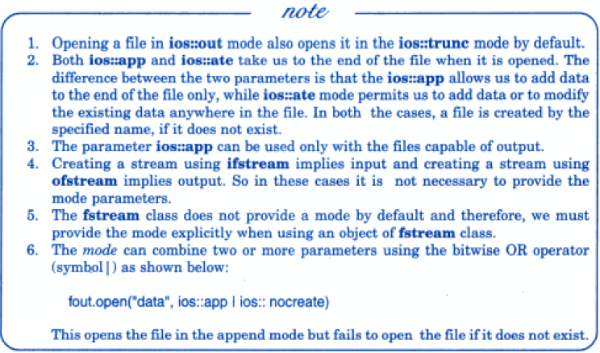


Slide 28
File pointers and their Manipulations
Each file has two associated pointers known as the file pointers.
Input pointer/get pointer
Output pointer/put pointer

Slide 29
Default actions
In read only mode the Input pointer is automatically set at the beginning.
In write only mode, the existing contents are deleted and output pointer is set at the beginning.
In append mode, the output pointer moves to the end of file.

Slide 30
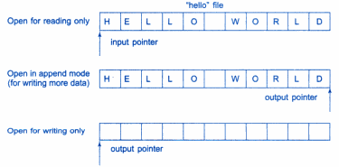
File opened in read mode:
  I/p pointer automatically set at beginning.
File opened in write mode:
  Existing contents deleted & O/p pointers sets at beginning.
To add more data, file is opened in append mode.

Slide 31
Functions for manipulation of file pointer
To move the file pointer to any other desired position inside the file. The file stream classes support the following to manage such situations:
  seekg()- moves get pointer to specified location
  seekp()- moves put pointer to specified location
  tellg()- gives the current position of get pointer
  tellp()- gives the current position of put pointer

Slide 32
Example
ofstream file1;
file1.open(“result”, ios::app);
int p=file1.tellp();
The value of p will represent the number of bytes in the file.
Infile.seekg(10);
Moves the file pointer to the byte number 10.

Slide 33
Specifying the offset
seekg(offset, refposition);
seekp(offset, refposition);
Offset represents the number of bytes the file pointer is to be moved from the location specified by the parameter refposition.
refposition can be:
  ios::beg
  ios::cur
  ios::end

Slide 34
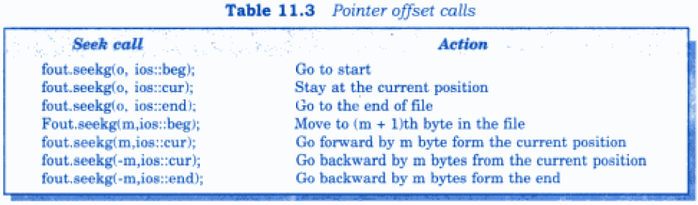
Some sample pointer offset
Pointer offset calls

Slide 35
Sequential input and output operations
put(),get() used to handle single character at a time.
write(), read() functions are used to handle a stream of data.
file.put(string);
file.get(ch);

Slide 36
main()
{
char string[80];
cout<<“enter a string”;
cin>>string;
int len= strlen(string);
fstream file;
file.open(“text”, ios::in|ios::out);
for(i=0;i<len;i++)
file.put(string[i]);
file.seekg(0);
char ch;
while(file)
{file.get(ch);
cout<<ch;
}}

Slide 37
write() and read()
infile.read((char *)&V, sizeof(V));
outfile.write((char *)&V, sizeof(V));
These functions take two arguments, first is address of variable V, second is length of that variable in bytes.

Slide 38
Example
main()
{
float height[4]={175.5,153.0};
ofstream outfile;
outfile.open(filename);
outfile.write(( char *)& height,sizeof(height));
outfile.close();

Slide 39
Reading and Writing Class object
The binary input output read() and write() are designed to write and read from disk file objects.
These functions handles entire structure of an object as a single unit .
function write() copies a class object from memory byte by byte with no conversion.

Slide 40
Example
void main()
{
fstream file;
inventory iobj;
file.open(“STOCK”, ios:: in|ios::out);
cout<<“enter detail for items”;
iobj.readdata();
file.write((char*) & iobj,sizeof(iobj));
File.seekg(0);
file.read((char*) & iobj ,sizeof(iobj));
iobj.writedata();
file.close();
}

Slide 41
Updating a file
Updating means to perform following tasks:
Displaying the contents of file
Modifying the existing file
Adding a new item
Deleting an existing item.

Slide 42
These actions require the file pointers to move to a particular location.
This can be easily implemented if file contains objects of equal length.
Size of each object can be obtained using:
int ob_len= sizeof(object);
Then location of desired object from beginning is:-
int location=(m-1)*ob_len;

Slide 43
total number of objects in a file:-
int n=file_size/ob_len;

Slide 44
ERROR HANDLING FUNCTION
FUNCTION | RETURN VALUE AND MEANING
eof() | returns true (non zero) if end of file is encountered while reading; otherwise return false(zero)
fail() | return true when an input or output operation has failed
bad() | returns true if an invalid operation is attempted or any unrecoverable error has occurred.
good() | returns true if no error has occurred.

